Slide 1
Managing inflammatory arthritis
Dr. Wes Fidler
January 20, 2017

Slide 2
Conflict of Interest Declaration:
Presenter: Dr. Wesley Fidler, MD, FRCP (C)
Title of Presentation: Managing Inflammatory Arthritis
Grants/Research Support: Janssen
Speakers Honoraria: Abbvie, Amgen, Roche, Janssen
Sponsorship to attend educational Program: Pfizer (ACR annual scientific meeting 2016)
Consulting Fees/Advisory Board: None
Other: None

Slide 3
Program Objectives
upon completion of this session you should be able to ….
Describe the optimal management of early Rheumatoid Arthritis and be able to initiate treatment with common DMARDs
Identify the special considerations in the use of corticosteroids and biologics in Inflammatory Arthritis
Understand the referral system and resources available for patients with rheumatic diseases in Northwestern Ontario

Slide 4
Optimal management of early rheumatoid arthritis

Slide 5
Case Presentation L. M. 28 year old indigenous woman
History
3 month history of pain, swelling and stiffness of hands, feet and shoulders.
Clinical Findings:
Synovitis in hands and feet
ESR 63, Rheumatoid Factor positive 335, anti-CCP >300
Family History:
RA in grandmother
Diagnosed with RA
RA: rheumatoid arthritis

Slide 6
How do you know it is RA?
How do you treat symptoms?
How do you treat the disease?

Slide 7
How do you know it is ra?

Slide 8
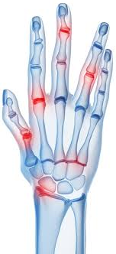
The Three Key Features of Inflammatory Arthritis
Inflammation
Destruction
Functional disability
Notes:
References:
Skeleton image from: SCIPRO/ SCIENCE PHOTO LIBRARY
Hand image from: ©iStockphoto.com/ Sebastian Kaulitzki
X-Ray image from: ©iStockphoto.com/ WILLSIE

Slide 9
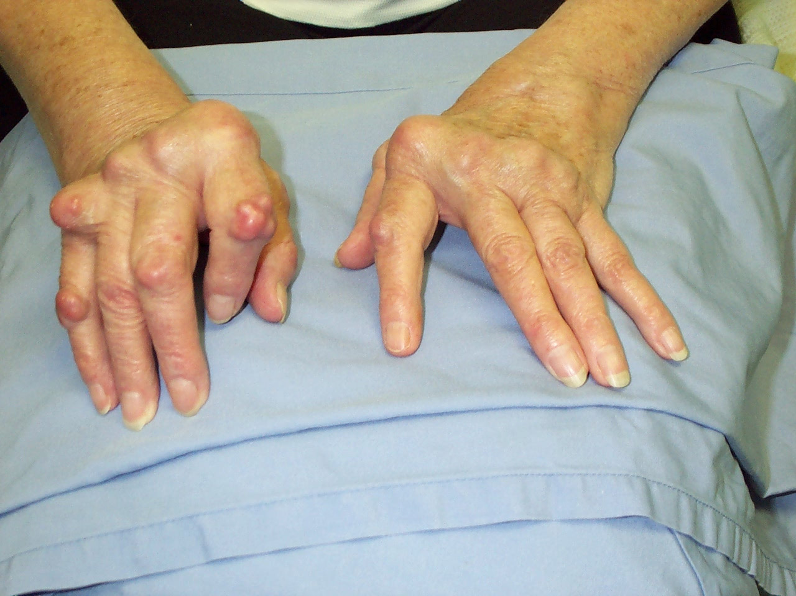
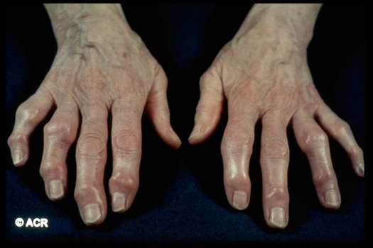
Inflammatory vs Non-inflammatory
Feature | Inflammatory Arthritis | Non-inflammatory Arthritis
Joint pain | With activity and at rest | With activity
Joint swelling | Soft tissue | Bony
Joint deformity | Common | Common
Local erythema | Sometimes | Absent
Local warmth | Frequent | Absent
Morning stiffness | >30 minutes | <30 minutes
Systemic symptoms | Common, especially fatigue | Absent
Adapted from: BCGuidelines.ca
Notes:
Inserted pictures of RA and OA hands to aid discussion

Slide 10
Joint Distribution: RA vs OA
Notes:
Add diagram: reference on picture

Slide 11
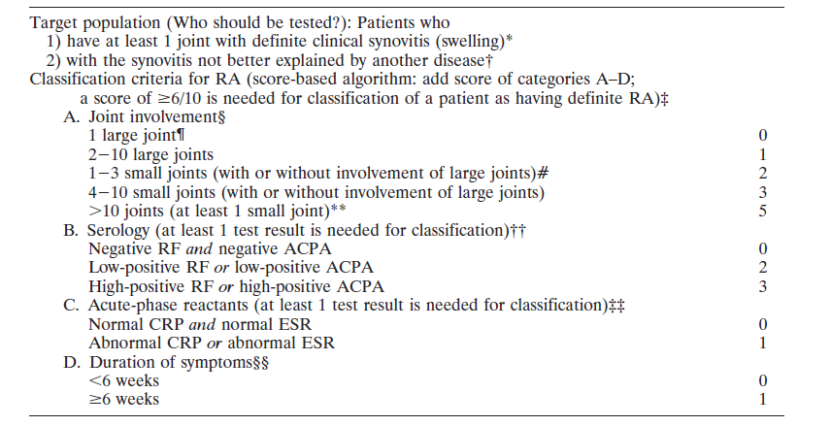
ACR/EULAR classification criteria (2010)
Complex tool used for classification and research
Adapted from: Vonkeman HE, van de Laar MAFJ. Curr Opin Rheumatol. 2013;25(3):354-359.

Slide 12
Epidemiology of Rheumatoid Arthritis
RA affects 1% of the population¹
Peak onset during working years²
Overall, more women affected^{3,4}
Women 2:1 over men in earlier age groups
This ratio decreases to 1.5:1 for females in RA onset after the age of 60⁶
Numerous causes⁵
Genetics (HLA-DR4), environmental factors (smoking)
No known cure²
RA: rheumatoid arthritis
Adapted from:
1. Averns H CRAJ 2013.
2. http://arthritis.ca/understand-arthritis/arthritis-facts-figures.
3. Guillemin et al. Ann Rheum Dis 2005;64:1427-30.
4. http://www.pdrhealth.com/diseases/rheumatoid-arthritis
5. Guillemin et al. Ann Rheum Dis. 2005.
6. Turkcapar N, Demir O, Atli T, et al. Arch Gerontol Geriatrics 2006;42:225-31.
Notes:
Averns H. CRAJ 2013;23(1):6-7. (Keep slide but add stats with older peak of RA dx of 70-79 yrs)
http://arthritis.ca/understand-arthritis/arthritis-facts-figures.
Guillemin et al. Ann Rheum Dis 2005;64:1427-30.
http://www.pdrhealth.com/diseases/rheumatoid-arthritis
Guillemin F, Saraux A, Guggenbuhl P et al. Prevalence of rheumatoid arthritis in France: 2001. Ann Rheum Dis. 2005;64:1427-30.
6. Turkcapar N, Demir O, Atli T, et al. Late onset rheumatoid arthritis: clinical and laboratory comparisons with younger onset patients. Arch Gerontol Geriatrics 2006;42:225-31.

Slide 13
Particular issues for northwestern ontario
Limited Rheumatology resources
1 Rheumatologist
High demand
High proportion of Indigenous persons - growing
Result
Lengthy average wait for consultation
Priority 1 (includes new onset RA) currently SIX MONTHS

Slide 14
Prevalence of RA in North American Indigenous Populations highest in the world
North American Indigenous have among the highest prevalence rates of RA in the world¹:
North American Caucasians: 0.5-1.6²
North American Aboriginals: 2 to 5%³
RA: rheumatoid arthritis
Adapted from: 1. Peschken CA, Esdaile JM. Rheumatic diseases in North America’s indigenous peoples. Semin Arthritis Rheum 1999;28:368-91.
2. Kvien TA . Epidemiology and Burden of Illness of Rheumatoid Arthritis. Pharmacoeconomics 2004; 22 Suppl. 1: 1-12. 3. Peschken. Rheumatoid Arthritis in a North American Native population: Longitudinal Followup and comparison with White population. J Rheum 2010 DOI 10.3899/jrheum.091452.4.
Notes:
To remove “pacific coast” data with thunder Bay stats, referencing Dr. Barnabe’s research.
Creating interaction: ? Guess a statistics
Between 0 and 5%, what do think is the prevalence of RA in BC?
Before showing an important statistic about the incidence of a specific conditions/incidence, ask participants to consult with their colleagues around them and to shout their answers.
Rather than having participants guess a statistic in response to your open-ended question, you may instead provide realistic answer options as a basis for guessing.

Slide 15
Thunder Bay and Northwestern Ontario Indigenous Population (Stats Canada)
Thunder Bay
2001: 8,200 of 109,020 (7.5%)
2006: 10,055 of 109,160 (9.2% of total vs 3.8% in Canada, 2.0% in Ontario)
2011: 11,690 of 108,359 (10.8% vs 4.3% in Canada)
Indigenous people make up about 20% of Northwestern Ontario’s population

Slide 16
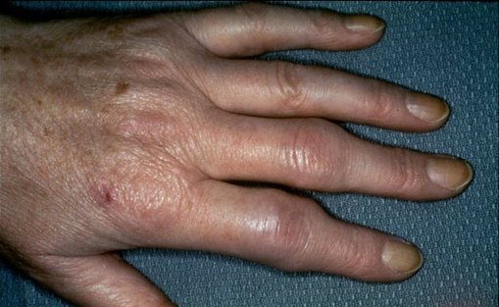
Early Rheumatoid Arthritis
Notes:
Creating interaction: ? What do you think is the most obvious clinical feature?
Encourage participants to share their thoughts.

Slide 17
Diagnosing Inflammatory Arthritis
History and physical exam extremely important in diagnosis
AM stiffness, constitutional symptoms, inflammation of multiple small joints in typical symmetrical distribution
Joint assessment can be done with confidence with some training
Video Dr. Lacaille : how do to joint count (https://www.youtube.com/watch?v=pETfVyZnPxg&feature=youtu.be)
Labs may help in diagnosis, assessing disease severity, and predicting prognosis
WHAT LABS?
Notes:
Edit bullet 2

Slide 18
Tests Should Support Clinical Diagnosis
CBC
ESR
CRP
RF
Anti-CCP
ANA
X-ray
CBC: complete blood count; ESR: erythrocyte sedimentation rate; CRP: c-reactive protein; RF: rheumatoid factor; CCP: cyclic citrullinated peptide

Slide 19
How do you treat symptoms?

Slide 20
NSAIDs
Glucocorticoids
Intraarticular
Systemic

Slide 21
How do you treat the disease?

Slide 22
When to Refer to a Specialist
Specialist intervention has been shown to improve RA outcomes
Referral based on clinical features combined with lab results
RA: rheumatoid arthritis
http://www2.gov.bc.ca/assets/gov/health/practitioner-pro/bc-guidelines/ra_guideline_summary.pdf
Notes:
Changes recommended – shift ‘referral to PT/OT with expertise…” to top, followed by ‘specialist intervention…” as need to modify ie. Cannot wait for intervention by specialist as the wait times may be extended. Remove ‘referrals should indicate urgent…” as they have a triage system that will classify priority of patient referrals given the referring MD has provided enough information.
Creating interaction:  Polling (Show of Hands)
This simple technique is effective if it is not overused. There are two things you need to do when using this technique:
1. Raise your hand to demonstrate that you expect them to raise their hand.
2. Ask a question that you know the majority of people will respond affirmatively to and raise their hand (otherwise it’s not very interactive!)
Another option: Please stand up if you are currently referring patients with suspected RA.

Slide 23
Case Presentation L. M. 28 year old indigenous woman
Returned after 3 months with marked swelling of hands, feet and wrist, both knees and right elbow
Took Ibuprofen 400 mg TID
Did not start recommended treatment – fearful of side effects
X-rays showed joint damage in hands and feet
Started MTX and HCQ
DMARD: disease-modifying anti-rheumatic drug; MTX: methotrexate, HCQ: hydroxychloroquine

Slide 24
3 months later: some improvement in symptoms but still has active disease.
WHAT NEXT?

Slide 25
Started Sulfasalazine combined with the other DMARDs (Triple Therapy)

Slide 26
Management of Early RA Whilst Waiting for Specialist Appointment
Refer to Arthritis Society and/or Rheumatic Diseases Program
Order blood work:
CBC, CRP, ESR, RF, (anti-CCP), ANA, Creatinine, liver tests
Viral studies: HepBsAg, HepBsAb, HepCAb, (HIV, parvovirus B19 IgG/M)
Pending labs, start NSAIDS/Analgesics
Order baseline x-rays of hands and feet
Consider Tuberculosis screening
CBC: complete blood count; CRP: c-reactive protein; ESR: erythrocyte sedimentation rate; RF: rheumatoid factor; ANA: antinuclear antibody, AST: aspartate aminotransferase; ALT: alanine aminotransferase; DMARDs: disease modifying anti-rheumatic drugs, MTX: methotrexate, HQ: Hydroxychloroquine; NSAIDs: nonsteroidal anti-inflammatory drugs, SSZ: Sulfasalazine
Adapted from: BCGuidelines.ca; Rheumatoid Arthritis - Diagnosis, Management and Monitoring; 2012
Notes:
Edit done
Hydroxychloroquine (6.5mg/kg lean body weight) or sulfasalazine (500 mg daily and increasing to 1 gm twice a day; after performing baseline CBC and LFTs) while the patient is waiting to be seen by a rheumatologist.
LFT: liver function test

Slide 27
ACR Recommendations for Treatment of Early RA
DMARD-Naïve Early RA
All patients with RA require early DMARD therapy
Short-term prednisone (<3 months) can be added
Methotrexate: preferred initial DMARD
Combination therapy is the standard of care in RA management
Low Disease Activity
Moderate or High Disease Activity
DMARD Monotherapy
DMARD Mono/Combo therapy
Moderate or High Disease Activity
Combination Traditional DMARDs or
TNF inhibitor +/- MTX or
Non-TNF Biologic +/- MTX
RA: rheumatoid arthritis; DMARD: disease-modifying anti-rheumatic drug
Singh JA, Saag KG, Bridges SL, et al.. Arthritis & Rheumatology. 2016;68(1):1-26. BC Medical Association. Rheumatoid Arthritis: Diagnosis, Management and Monitoring Summary. http://www2.gov.bc.ca/assets/gov/health/practitioner-pro/bc-guidelines/ra_guideline_summary.pdf.
Notes:
Here are the ACR recommendations for a patient with early RA.
All patients with RA should be on DMARD therapy
Short-term prednisone can be added to quickly to help to reduce a flare
MTX is the preferred initial DMARD
Combination is the standard of care for RA management
References
Singh JA, Saag KG, Bridges SL, et al.. Arthritis & Rheumatology. 2016;68(1):1-26.
BC Medical Association. Rheumatoid Arthritis: Diagnosis, Management and Monitoring Summary. http://www2.gov.bc.ca/assets/gov/health/practitioner-pro/bc-guidelines/ra_guideline_summary.pdf.

Slide 28
Management of Early RA Whilst Waiting for Specialist Appointment (Cont’d)
When confident of diagnosis, consider starting DMARDs:
MTX 20 mg per week with folic acid, HCQ (400 mg OD- 6.5mg/kg lean body weight) or SSZ (1 G BID)
If uncertain about management, call rheumatologist for assistance
Specialist referral and be sure to indicate “new onset of RA.”
Adapted from:
Singh J. et al. 2015. 2015 ACR Guideline for the Treatment of Rheumatoid Arthritis.
http://www.rheumatology.org/Portals/0/Files/ACR%202015%20RA%20Guideline.pdf
Notes:
To change: if confident of diagnosis, consider starting a DMARD. MTX and HCQ are options. Remove 40 mg IM prednisone. If uncertain about med management, call rheumatologist for assistance.
Remove bullet point #3. Add slide after this: how to initiate and monitor MTX/HCQ. If must start DMARD, prefer MTX. Add – risk of not treating Patients may experience or simply fear adverse effects from their medication
The risk of under-treating disease and allowing inflammation, joint destruction and disability is also serious and life-threatening.
“…..

Slide 29
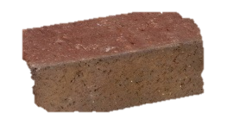
Addressing Patient Fear
Always balance risks versus potential benefits
Frame Adverse Events vs. better RA control
Undertreated RA will progress to irreversible damages
Likelihood of serious adverse events
High likelihood of joint destruction, disability, and serious, life-threatening complications
Opinions from commitee of experts

Slide 30
DMARDs are Safe When Monitored Adequately
Drug | Monitoring | What to Watch | Time for benefit
Hydroxychloroquine | Ophthalmologic exam q6-12 months | Eye damage (macular, retinopathy) | 2-6 months
Leflunomide | Hep B & C at baseline; CBC, LFT monthly Blood pressure monthly | Teratogenicity, lung | 1-3 months
Methotrexate (with folic acid 5 mg po once weekly) | Hep B & C at baseline, CBC, ALT, albumin, creatinine q mo x 6 months then q 2 mo | Teratogenicity, lung | 1-2 months
Sulfasalazine | CBC, LFT, creatinine monthly x 3 mo, then q 3 mo | GI, sulfonamide reaction | 1-3 months
CBC: complete blood count; DMARDs: disease-modifying anti-rheumatic drugs; LFT: liver function test
Adapted from: 1. http://www.uspharmacist.com/content/c/30672/ 2. Sweetman SC, ed. Martindale: The Complete Drug Reference. 34th ed. London, UK: Pharmaceutical Press; 2005 [electronic version]. 3. American College of Rheumatology Subcommittee on Rheumatoid Arthritis Guidelines. Guidelines for the management of rheumatoid arthritis—2002 update. Arthritis Rheum. 2002;46:328-46. 4. BC Guidelines.ca consulted October 2, 2015 at: http://www2.gov.bc.ca/assets/gov/health/practitioner-pro/bc-guidelines/ra_appendix_a.pdf

Slide 31
Early Diagnosis & Treatment of RA
New onset RA requires urgent care
Involve arthritis care specialists (Arthritis Society, Rheumatic Diseases Program at St. Joseph’s Care Group)
Start DMARDs within 2 months of symptoms.
New onset RA should be seen by a rheumatologist
State ‘new onset of RA’ on referral.
RA: rheumatoid arthritis; DMARDS: disease-modifying anti-rheumatic drugs
Notes:
To change: add ‘refer to rheumatologist early after initiating treatment within 2 months. While patients are waiting, consider other rheumatology resources such as TAS, Rheumatic Disease Program at St-Joseph’s Care Group. For rheumatologist to see RA patients (or inflammatory arthritis patients) in a timely manner, non-inflammatory cases should be managed by the primary care provider and the allied health professional team.”

Slide 32
How to Improve Care for rheumatic diseases in Northwestern Ontario?
Non-inflammatory cases should be managed by the primary care provider and the allied health professional team.
Treatment of Rheumatoid Arthritis should start early, at time of diagnosis.

Slide 33
Inflammatory Arthritis in Indigenous Populations
Unique Features
Notes:
Change to same picture as slide #1

Slide 34
Case Presentation l. m.
She is today in your office: Triple combo therapy – compliance spotty
Parameter | Data
Swollen joints | 11
Tender Joints | 15
CRP | 18 mg/L
HAQ | 2.125
Upon examination:
Marked deformities in her hands and feet
Flexion contracture of right elbow and marked swelling of right knee
unable to walk long distances
WHAT NEXT?

Slide 35
Case Presentation L. M.
Treatment Plan
TB skin test
Vaccinations updated
anti-TNF and methotrexate
Notes:
Creating interaction: ? Guess what went wrong with Angela situation
As participants are likely to be intimidated to speak up. Invite participants to think about the question, pair up with the person next to them and formulate a common answer.
It will be easier to point to people, asking to share what their team has come up with.

Slide 36
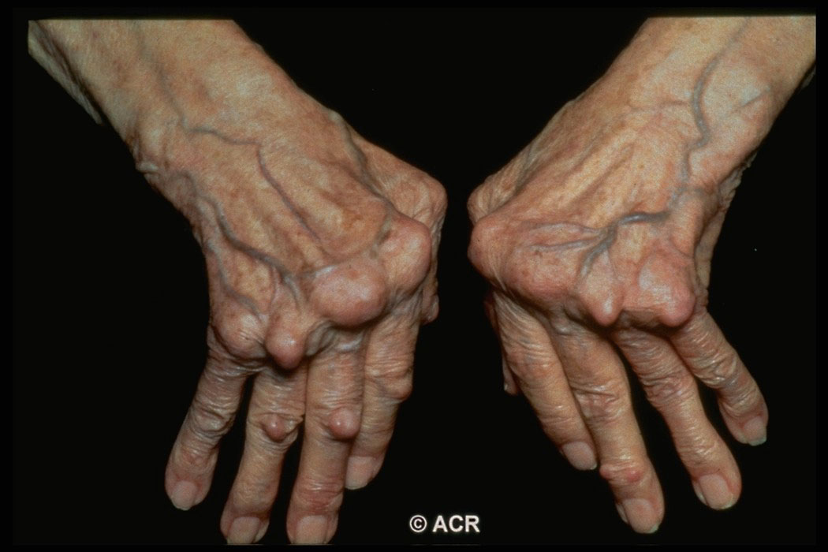
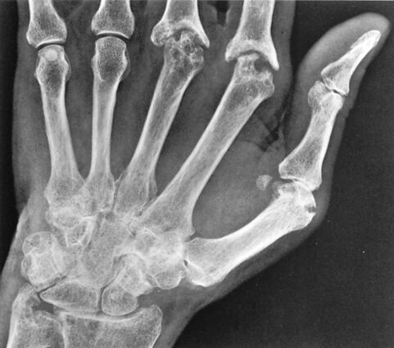
Case Presentation l. m.
3 months later:
Parameter | Data
Swollen joints | 0
Tender Joints | 3
X-Ray | erosion
HAQ | 1.25
CRP | 3 mg/L
Upon examination:
Marked deformities in her hands and feet
Flexion contracture of right elbow and right knee
unable to walk long distances

Slide 37
Case Presentation L. M.
Disease controlled but function is impaired
What went wrong?
What should we do to prevent this from happening again?

Slide 38
RA: Inflammation in Early Stages, Joint Destruction Later
Early RA Intermediate Late
Inflammation
Disability
Radiographs
Severity (arbitrary units)
0
5
10
15
20
25
30
Duration of disease (years)
Graph: Used with permission of Journal of Rheumatology.
X-ray: © 2012 American College of Rheumatology. Used with permission.
Adapted from: Kirwan JR. 1999, 2001.
Notes:
PRESENTER: RHEUMATOLOGIST
Speaker notes:
In terms of disease progression, the main determinant of disability early in disease is inflammatory joint symptoms, while joint destruction dominates in the late stages. If not treated early to slow or halt disease progression, RA may continue to increase in severity over time by advancing from the early inflammation stage to that of joint damage and functional disability in late disease. Thus, early intervention gives the patient the best chance of a good outcome, as demonstrated by the classic data in the next slide.
References:
Kirwan JR. Links between radiological change, disability, and pathology in rheumatoid arthritis. J Rheumatol 2001; 28:881−886.
Kirwan JR. Conceptual issues in scoring radiographic progression in rheumatoid arthritis. J Rheumatol 1999;26:720−725.

Slide 39
Identify the special considerations in the use of corticosteroids and biologics in Inflammatory Arthritis

Slide 40
Corticosteroids (Cortisone, Prednisone, Prednisolone)
Corticosteroids should only serve as a“bridge”to safer disease-modifying drugs
Rapidly reduce inflammation
Side effects in majority of patients
Use must be limited
Low-dose, short-term

Slide 41
Biologics
Large protein molecules
Targeted to block specific mediators of inflammation
Injectable: perfusion or SC injection
Costly ($20-40,000/year)
Limited to patients failing DMARDs
SC: sub-cutaneous; DMARDs: disease-modifying anti-rheumatic drugs
Notes:
http://www.fda.gov/AboutFDA/CentersOffices/OfficeofMedicalProductsandTobacco/CBER/ucm133077.htm

Slide 42
Biologic Drugs for the Treatment of Inflammatory Arthritis are Prescribed by Specialists
Anti-TNF | Indications | Regimen in Adult Rheumatology
Adalimumab | RA, AS, PsA, JIA, PsO, CD, UC | SC every 2 weeks
Certolizumab | RA, AS, PsA, PsO | SC every 2 weeks
Etanercept | RA, AS, PsA, PsO, JIA | SC bi-weekly or weekly
Golimumab | RA, AS, PsA | SC monthly
Infliximab | RA, AS, PsA, PsO, CD, UC | IV loading dose then every 4-8 weeks
Interleukin-6 Inhibitors
Tocilizumab | RA, JIA | Monthly IV or SC
Depletes CD20 Antibody-forming Lymphocyte B Cells
Rituximab | RA | Every 6-12 months IV
Blocks T Cell Co-stimulation
Abatacept | RA | Monthly IV or weekly SC
RA: rheumatoid arthritis; AS: ankylosing arthritis; PsA: psoriatic arthritis; JIA: juvenile idiopathic arthritis; PsO: psoriasis; CD: Crohn’s disease; UC: ulcerative colitis; SC: sub-cutaneous; IV: intravenous
Adapted from: Hazeltine and Tremblay, 2012, Respective product monographs.
Notes:
Creating interaction:  Pull and push Question ‒ Do you recognize any?
If you know that the participants know at least some of the points you have on your slide, avoid lecturing to them. Instead, before showing the slide, pose an open-ended question to the audience that, if they answer it correctly, you can PULL from them what they know (the content on your slide).
If they are able to give you all of the points on your slide, congratulate them and go to the next slide.
If they miss one or more important points, show your slide and PUSH only these points at them that they missed (don’t repeat everything on the slide).
This technique is effective to help participants recall and verbalize what they know already. It can also allow you to save time or spend more time where they have limited knowledge.

Slide 43
Other Drugs for the Treatment of Inflammatory Arthritis
Name | Class | Indications | Doses for Adult Rheumatology
Tofacitinib | Targeted Synthetic DMARD | RA | 5 mg po bid
RA: rheumatoid arthritis
Adapted from respective product monographs.

Slide 44
Biologic Key Points – Tolerability
Biologics are generally well tolerated
Most common are injection site and infusion reactions
They target various immune system and this increases the risk of:
Opportunistic infection (also occurring with corticosteroids)
Tuberculosis
Risk of certain cancers (also ↑ in RA)
Vaccine-preventable diseases
Adapted from:
Boyman O, Comte D, Spertini F. Adverse reactions to biologic agents and their medical management. Nat Rev Rheumatol. 2014;10(10):612-627. doi:10.1038/nrrheum.2014.123.
Singh JA, Wells GA, Christensen R, et al. Adverse effects of biologics: a network meta-analysis and Cochrane overview. In: Cochrane Database of Systematic Reviews. John Wiley & Sons, Ltd; 2011.
Notes:
Biologics reduce immune response and thus are associated with some adverse effects.
The most common AE are injection site and infusion reactions
Site: Erythema, itching, pain and swelling
Infusion: fever, shaking chills, musculoskeletal pain, nausea, vomiting, diarrhea and skin rashes
They target the immune system and thus increase the risk of:
Opportunistic infection – prednisone is in many cases worse for this. If the disease is controlled the infection risk is reduced as the patient is healthy.
Risk of certain cancers (also ↑ in RA)
Vaccine-preventable diseases
The KEY is to balance the risk versus the benefit. These drugs can be transformational and although they cause AE they can reduce long-term complications of RA.
We should not scare patients but frame AE vs. ↑ in RA control
References:
Boyman O, Comte D, Spertini F. Adverse reactions to biologic agents and their medical management. Nat Rev Rheumatol. 2014;10(10):612-627. doi:10.1038/nrrheum.2014.123.
Singh JA, Wells GA, Christensen R, et al. Adverse effects of biologics: a network meta-analysis and Cochrane overview. In: Cochrane Database of Systematic Reviews. John Wiley & Sons, Ltd; 2011.

Slide 45
REASONS TO STOP tnf-INHIBITOR?
What if L. M. has infection?
What if L. M. is undergoing surgery?

Slide 46
Patients on Biologics: Vaccination Essentials
Vaccines are recommended for RA patients before or during treatment (Tdap, pneumococcal, +/- Hep B)
Regular influenza (yearly) and pneumococcal vaccinations (5 years), Td (10 years)
Live vaccines should not be given concurrently with biologics (Measles, mumps, rubella, yellow fever, oral typhoid, rotavirus, varicella, herpes zoster, oral polio, nasal flu, and BCG)
RA: rheumatoid arthritis; BCG: bacillus Calmette-Guérin.
Adapted from Tugwell P et al., 2011.
Notes:
Add: “If your patient looks like will be proceeding to needing biologic treatment, please update their vaccinations.”
Speaker notes:
This slide is a recap of the vaccination tips presented in module 2, under “safety”.
Pharmacists can now administer vaccinations in most provinces, so emphasize that this is important information for your audience.
RA patients often do not receive the correct vaccinations at the right times, so the pharmacist can be very helpful here.
Reference:
Tugwell P, Singh JA, Wells GA. Biologicals for rheumatoid arthritis. BMJ 2011;343:d4027.

Slide 47
summary
Vaccinations need to be updated before starting a biologic
Tuberculosis testing must be done prior to biologic therapy
Discontinue biologic:
Prior to surgery
During infections

Slide 48
Overall Conclusions
In RA, HCPs must grasp the window of opportunity to treat early
Start DMARD as soon as possible
Refer to rheumatologist while being aware of limited resources
Make use of non-rheumatologist resources for non-inflammatory arthritis
Involve non-physician experts (Arthritis Society, RDP)
Collaboration is the key!
RA: rheumatoid arthritis; HCPs: healthcare professionals

Slide 49
Understand the referral system and resources available for patients with rheumatic diseases in Northwestern Ontario

